Slide 1

Cricket Score Prediction
Welcome to our cricket score prediction section! Here, you can find all the latest updates on your favorite cricket teams and matches. Our experts use advanced algorithms to predict the score of each match, so you can stay informed and make the best decisions for your fantasy cricket team. Let's dive in and see what's in store for the upcoming matches!

Slide 2
Problem Statement
Introduction : Predicting cricket scores holds significant importance across various aspects of the game, impacting strategy development, fan engagement, and betting markets.
1. Strategy Development
2. Player Performance Analysis
3. Fan Engagement
4. Betting Markets
5. Broadcasting and Commentary
Objective:- The main objective of the cricket score prediction model is to accurately predict either the total score of a cricket match or the individual scores of each team participating in the match.
Scope:- The scope of the cricket score prediction problem encompasses various types of cricket matches, formats, and conditions.
This includes, Types of Matches, Format of the Game.
Data Source:- Historical Match Data, Player Statistics, Pitch Conditions, Weather Conditions,

Slide 3

OBJECTIVES
**Objective:**
- Develop an accurate and reliable predictive model for forecasting cricket match scores.
**Data Utilization:**
- Leverage historical and contextual data for analysis.
**Machine Learning Algorithms:**
- Utilize advanced machine learning algorithms for in-depth analysis.
**Factors Considered:**
- Analyze various factors including team performance, player statistics, match venue, weather conditions, and recent form.
**Precise Predictions:**
- Generate precise predictions for upcoming cricket matches.
**User Segments:**
- Target cricket enthusiasts, fantasy sports players, and sports analysts.
**Enhanced User Experience:**
- Improve user experience by providing valuable insights.
**Informed Decision-Making:**
- Enable users to make informed decisions and predictions.

Slide 4

LITERATURE SURVEY
SNO | TITLE OF PAPER | METHOD | RESULTS | ADVANTAGES | DRAWBACKS
1. | The Cricket Winner Prediction With Application of Machine Learning and Data Analytics | Data Science, Machine Learning, Modelling, | Prediction and analysis of score with the help of some prediction algorithms like LR, RF, and many others. | Informed Decision-Making, Performance Analysis, Strategic Planning, Fan Engagement | Inherent Uncertainties in Cricket, Limited Historical Data, Non-Quantifiable Variables, Data Quality and Reliability
2. | Prediction of Indian Premier League-IPL 2020 using Data Mining Algorithms | Data Mining Algorithms | Analysis of score during short format match on the basis of various machine learning algorithms | Pattern Recognition, Complex Relationship Analysis, Handling Non-Linearity, Scalability | Overfitting, Limited Interpretability, Data Quality Issues
3. | IPL win prediction System to improve Team Performance using SVM | SVM | Importance of machine learning, deep learning and neural network and prediction analysis | Pattern Recognition, Flexibility, Automation, Image and Speech Recognition | Interpretability, Computational Intensity, High Dimensionality, Bias and Fairness, Lack of Understanding of Causation

Slide 5
4. | Prediction on the IPL data using machine learning techniques in R package | Machine Learning, R Package | In this journal they applied various prediction algorithms and opter one that has higher accuracy | Dplyr, tidyr, ggplot2, caret, glmnet | Limited Data Availability, Overfitting:

Slide 6

Existing System
Existing System
Overview of Cricket Score Prediction
Cricket score prediction has become a crucial aspect of the sport, especially with the rise of popular formats like T20.
Fans, analysts, and fantasy sports enthusiasts seek reliable methods to anticipate match outcomes.
Traditional Methods
Discuss any traditional or manual methods currently employed for predicting cricket scores.
Highlight the challenges and limitations of these methods, such as reliance on subjective judgment or lack of data-driven insights.
Challenges Faced
Expert Opinion:
Historically, cricket score predictions often relied on the expertise of seasoned cricket analysts, commentators, and former players.
Expert opinions were based on their knowledge of player performance, team dynamics, and conditions, but subjectivity could impact accuracy.
Data Sources
Data Sources Traditionally Used for Cricket Score Prediction:
Historical Match Data:
Description: Historical match data includes detailed statistics from past cricket matches. This encompasses information on runs scored, wickets taken, batting and bowling averages, and match outcomes.
Source: Cricket scorebooks, official cricket databases, and statistical repositories.
Scope for Improvement
Need for Advancements in Cricket Score Prediction:
Dynamic Nature of T20 Cricket:
Challenge: T20 cricket is known for its dynamic and fast-paced nature, making it inherently unpredictable.
Advancement Needed: Traditional methods struggle to adapt to the rapid changes and unpredictability in T20 matches. Advanced algorithms can better analyze dynamic game situations and evolving player strategies.
User Experience
Limited Scope for Real-time Analysis:
Feedback: Users express a desire for real-time insights during matches.
Limitation: Traditional methods often lack the capability to incorporate real-time data, restricting their ability to adjust predictions based.
Conclusion: The current landscape of cricket score prediction faces several limitations and challenges, ranging from subjectivity and reliance on historical data to struggles in adapting to the dynamic nature of T20 cricket. The need for real-time analysis, consideration of diverse factors, and improved engagement features is evident. To overcome these challenges and provide more accurate predictions, there is a clear necessity for a more advanced and sophisticated predictive model. Machine learning and data-driven approaches have the potential to revolutionize cricket score prediction by incorporating a broader range of factors, adapting to real-time dynamics, and enhancing user engagement. The pursuit of a more advanced model is essential to meet the evolving demands of the modern cricketing environment and to provide fans, analysts, and stakeholders with reliable insights into match outcomes.

Slide 7

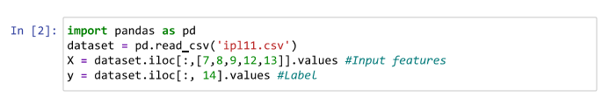
Proposed System with system architecture
The provided program uses several Python libraries and frameworks for various tasks. Here are the key programs and libraries used in the code:
1. Pandas (`import pandas as pd`):
- Used for data manipulation and analysis.
2. Features Used:
runs
wickets
overs
striker
non-striker
Why didn’t I use other features?
While experimenting, all the other features didn’t make much difference in results. You can use a different combination of features and test the code on them.
Label Used: total

Slide 8
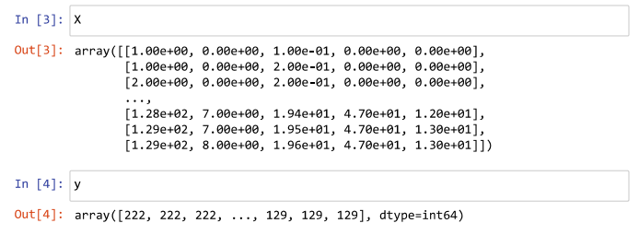

3. Splitting data into training and testing set:-
We will train our model on 75 percent of the dataset and test the model on remaining dataset.
4. Feature Scaling the data
Feature scaling is a very important part of machine learning

Slide 9
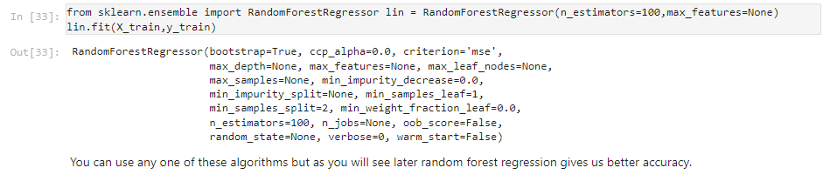
5. Training the dataset:-
Using Linear Regression Algorithm
6. Using Random Forest Regression Algorithm

Slide 10
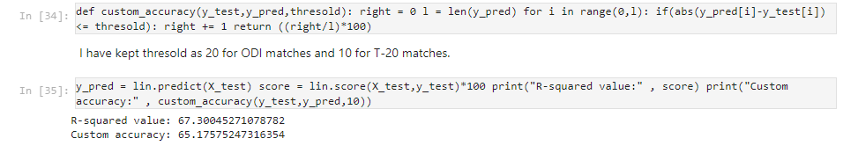
7. Testing the dataset on trained model
R-squared value
R-sqaured is a statistic that will give some information about the goodness of fit of a model. In regression, the R-squared coefficient of determination is a statistical measure of how well the regression predictions approximate the real data points. An R-squared value of 1 indicates that the regression predictions perfectly fit the data.
Custom accuracy
I have defined my own function to measure accuracy of model. Custom Accuracy is defined on the basis of difference between the predicted score and actual score. If this difference falls below a particular thresold, we count it as a correct prediction.
8. Testing with a custom input

Slide 11
Data Collection
Introduction: Data collection forms the bedrock of accurate cricket score prediction. The proposed system relies on a comprehensive and diverse dataset to fuel its advanced machine learning algorithms.
Sources:
Historical Match Data
Player Performance Records
Team Records
Venue and Pitch Reports
Weather Data
Player Fitness and Injury Reports
Bookmaker Odds
Fan Surveys and Popular Sentiment
Team News and Strategies
Umpire and Officiating Data
Conclusion: By comprehensively harnessing data from these varied sources, our system is poised to deliver precise and insightful cricket score predictions, meeting the evolving demands of the modern cricketing landscape.

Slide 12
Methodology
Data Collection:
Data Preprocessing:
Feature Engineering:
Machine Learning Model Selection:
Model Training
Multifactorial Analysis:
Continuous Learning and Adaptability:
Testing and Validation:
User Interface Design:
Enhanced Engagement Features:
Conclusion: By following this systematic methodology, the proposed cricket score prediction system aims to provide accurate, adaptable, and engaging predictions, offering a valuable tool for cricket enthusiasts, analysts, and stakeholders.

Slide 13
Software & hardware requirements
Software Requirements:
1. Programming Languages and Frameworks:
Python: Python is a popular choice for building machine learning models due to its extensive libraries and frameworks such as randomForest, Pandas, Numpy, Streamlit for machine learning tasks.
2. Machine Learning Libraries:
scikit-learn: scikit-learn is a versatile machine learning library in Python, offering a wide range of algorithms for classification, regression, clustering, and more.
3. Data Analysis and Visualization Tools:
Pandas: Pandas is a Python library for data manipulation and analysis, commonly used for preprocessing and exploring datasets.

Slide 14
Software Requirements:
4. Development Environment:
Integrated Development Environment (IDE): Choose an IDE such as PyCharm, Jupyter Notebook, Spyder, or Visual Studio Code for writing, debugging, and running code efficiently.
Version Control: Utilize version control systems like Git for managing code changes and collaborating with team members.
Hardware Requirements:
1. Processor and Memory:
CPU: A multi-core processor with sufficient computational power is essential for training complex machine learning models efficiently.
RAM: Adequate RAM capacity is crucial for handling large datasets and model training. A minimum of 8GB RAM is recommended, although higher capacities may be necessary for more extensive datasets and resource-intensive models.
2. Storage:
Hard Drive or SSD: Sufficient storage space is needed for storing datasets, model checkpoints, and other project files. An SSD is preferred for faster data access and model training.
Graphics Processing Unit (GPU):
GPU: For deep learning tasks, a GPU accelerates model training significantly compared to a CPU. NVIDIA GPUs are commonly used for deep learning tasks, with models such as NVIDIA GeForce RTX or NVIDIA Tesla suitable for different requirements.

Slide 15
Implementation (algorithms used)
Linear Regression (LinearRegression)
- Linear regression is a simple and widely used algorithm for predicting numeric outcomes, such as total runs scored in a cricket match. It models the relationship between independent variables (e.g., batting order, pitch conditions) and the dependent variable (total runs) using a linear equation.
2. Decision Trees and Random Forests (RandomForestRegressor)
- Decision trees and random forests are popular algorithms for classification and regression tasks. In cricket score prediction, decision trees can be used to analyze factors affecting scoring patterns and predict match outcomes based on historical data.

Slide 16
Implementation (algorithms used)
5. Time Series Analysis
- Time series analysis techniques, including autoregressive integrated moving average (ARIMA) models and seasonal decomposition, can be applied to analyze and forecast time-dependent variables, such as runs scored in cricket matches.
6. Feature Engineering
- Feature engineering involves selecting, transforming, and creating relevant features from the raw data to improve model performance.
7. Ensemble Methods
- Ensemble methods combine multiple base models to produce a more robust and accurate prediction. Techniques such as model averaging, stacking, and boosting can be applied to combine the predictions of diverse algorithms and leverage their complementary strengths in cricket score prediction.
8. Evaluation Metrics
- Various evaluation metrics, such as mean absolute error (MAE), root mean square error (RMSE), and R-squared (R²) coefficient of determination, are used to assess the performance of cricket score prediction models and compare different algorithms. These metrics quantify the accuracy and reliability of predictions relative to the actual match outcomes.

Slide 17
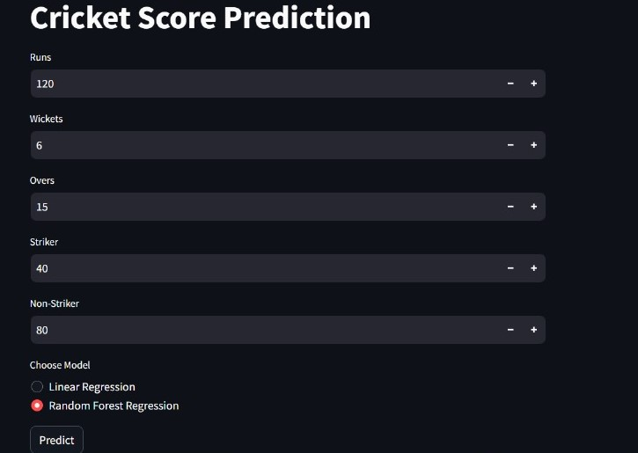
Results;
Impact on Decision-Making:
The practical impact of cricket score prediction models lies in their ability to inform decision-making processes, such as team strategy development, player selection, and in-game tactics. Models that accurately predict match scores and outcomes can provide valuable insights to coaches, players, and cricket stakeholders, leading to better-informed decisions and improved performance on the field.

Slide 18
Future enhancements;
Future enhancements in cricket score prediction can focus on several aspects to improve the accuracy, robustness, and applicability of prediction models.
Incorporating Advanced Features
- Enhance feature engineering by incorporating advanced player statistics, such as player performance under specific match conditions (e.g., home vs. away matches, day vs. night matches), player form trends, and player matchups against specific opponents.
2. Ensemble Learning Techniques
- Explore ensemble learning techniques, such as model stacking, to combine the predictions of multiple base models and leverage their complementary strengths.
3. Time Series Analysis
- Apply advanced time series analysis techniques, such as recurrent neural networks (RNNs) and attention mechanisms, to model temporal dependencies and patterns in cricket match data more effectively.
4. Dynamic Model Updating
- Implement mechanisms for dynamic model updating and adaptation to incorporate new data and insights as matches progress. Real-time updates on match events, such as wickets, boundaries, and run rates, can inform adjustments to prediction models and enhance their accuracy in predicting final match scores.

Slide 19
Conclusion
1. In conclusion, cricket score prediction holds immense potential to revolutionize various aspects of the game, from strategy development to fan engagement and betting markets. Through the application of advanced machine learning algorithms, statistical modeling techniques, and domain expertise, cricket score prediction models offer valuable insights into match dynamics, player performances, and match outcomes.
2. By leveraging historical match data, player statistics, pitch conditions, weather forecasts, and other relevant factors, prediction models can accurately forecast total scores or individual team scores in cricket matches across different formats and conditions. These predictions empower teams and coaches to make informed decisions, optimize strategies, and maximize performance on the field.
3. Moreover, cricket score prediction models enhance fan engagement by adding an element of excitement and anticipation to matches. Fans can use predictions to participate in fantasy cricket leagues, make betting decisions, and engage in discussions about match outcomes, leading to a more vibrant and interactive fan experience.
4. Overall, cricket score prediction represents a significant advancement in sports analytics and decision-making, with far-reaching implications for teams, players, fans, and stakeholders. As technology continues to evolve and data analytics techniques advance, cricket score prediction models will continue to evolve.

Slide 20
References
References
Choudhary, A., & Singh, A. (2020). "Cricket Match Result Prediction using Machine Learning Algorithms." International Journal of Advanced Computer Science and Applications.
Khan, M. A., & Gulzar, S. (2018). "Predictive Modeling for Cricket Match Outcome using Machine Learning Algorithms." Procedia Computer Science.

Slide 21
We would like to express our sincere gratitude for the opportunity to present our Cricket Score Prediction in today's Session. We appreciate Our Teachers Who have given us this opportunity to showcase our Skills. Your guidance and encouragement have been instrumental in enhancing our understanding of the subject. Thank you for providing a platform for academic exploration, and we as a Team look forward to further learning and growth under your mentorship.
YOUR’s SINCERELY;
SYED KHALID ALI

